Slide 1


Pearl Elenwo Inc.
Employees Performance - HR Analytics
Contact Information
Address: 504 Pearl St., Manchester
Phone: +44-7400-780000
Email: hello@rpearlelenwo.com
Website: www.pearlelenwo.com

Slide 2


Table of Content
Objectives
Key Insights
Challenges and Solutions
Final Recommendation

Slide 3
Objectives
The objective of this project is to leverage HR Analytics to gain actionable insights into employee performance across the organization. By analyzing employee data, the project aims to::
Understand performance distribution across departments, job roles, education levels, and otherrelevant factors
Segment employees based on performance levels to identify high performers, average performers, and those requiring additional support.
Identify key drivers of high performance, such as tenure, training, education level, and departmental trends.
Develop data-driven strategies for improving employee engagement, retention, and overall organizational effectiveness.

Slide 4
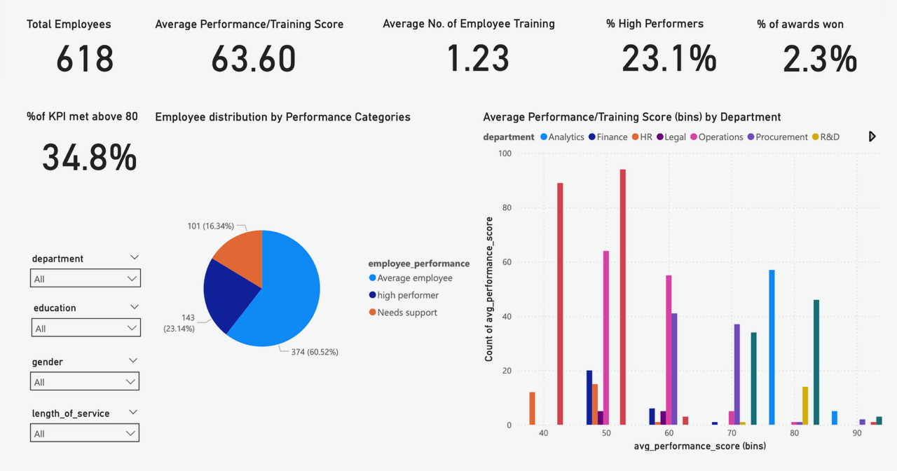

Slide 5
Key Insights
The Analytics department had the highest performance score of 84.82% while the Sales and Marketing department had the lowest score of 49.88%.
Based on educational level, employees with Master's and above had the highest performance score of 65.25%, while those with Bachelor's had the lowest performance score of 62.89%.
86.6% of the Bottom 15 Performers are from the Sales and Marketing department.
16.34% of the total employees need support, particularly employees in the Sales and Marketing and HR departments.
47.59% of the Sales and Marketing employees need support.
42.86% of the HR employees need support.
Master's and above shows that higher education often correlates with high performance and longer tenure in certain departments, whereas lower education indicates low performance and shorter tenure in most departments.
Findings reveal that out of all employees, 69.4% have a Bachelor’s degree, and 48.5% of the 69% are males
Male employees with a Master’s degree and above have a longer tenure, on average, 7 to 8 years
Female employees have longer tenure HR and Technology departments
Female employees show the longest tenure.
Employee Development and Upskilling Programs
To enhance employee skills and prepare them for future roles.
Status: Rollout phase.
Performance Management System Revamp
To boost employee engagement and satisfaction across the organization.
Status: Initiatives have been launched.

Slide 6
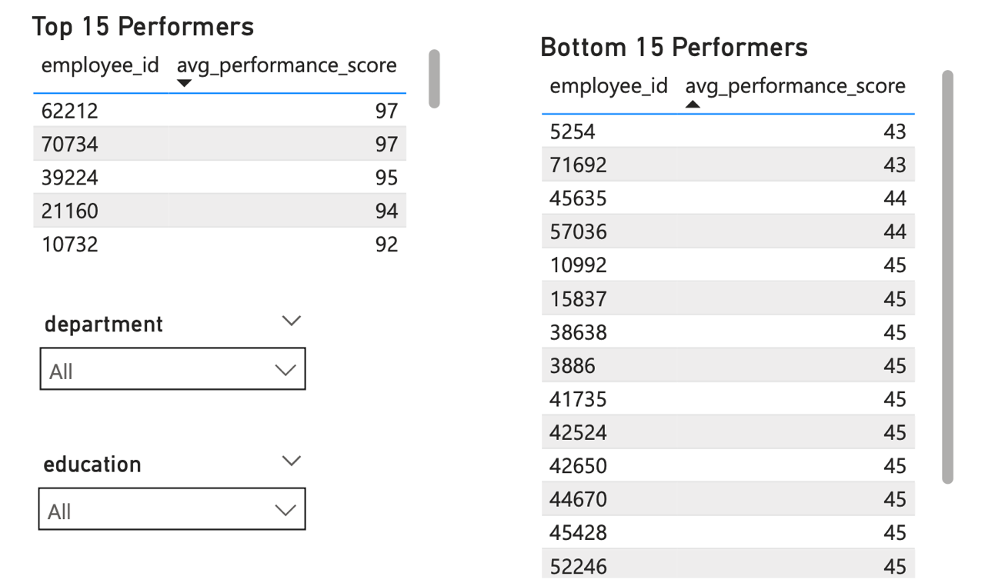

Slide 7
Challenges and Solutions
Talent Management Decisions
Focus on Sales & Marketing Talent
47.59% of Sales & Marketing employees need support, and they contribute to 86.6% of the Bottom 15 Performers.
Action:
Conduct a deep-dive review into Sales & Marketing roles, expectations, and KPIs.
Identify and address gaps in skills, resources, or management practices.
Consider restructuring roles or introducing clearer performance metrics.
Prioritize Support for HR Department
42.86% of HR employees also need support, indicating a systemic issue.
Action:
Assess job design, workload, and career growth opportunities in HR.
Implement targeted coaching and peer mentoring programs.

Slide 8
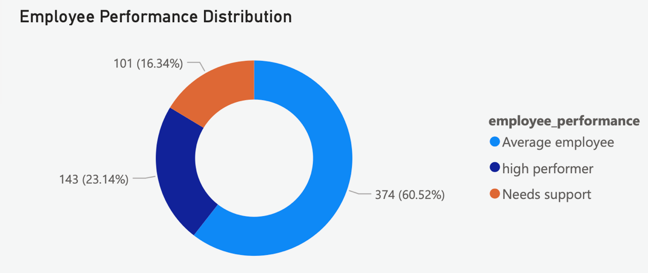

Slide 9
Challenges and Solutions
Leverage High-Performing Departments (e.g., Analytics & Technology)
Analytics has the highest average performance score (84.82%).
Technology has longer tenure, especially for female employees.
Action:
Use these departments as benchmark cases.
Facilitate cross-departmental mentoring and knowledge-sharing initiatives.
Gender & Tenure Strategy
Female employees show longer tenure, particularly in HR and Technology.
Males with Master’s degrees tend to have longer tenure (7-8 years).
Action:
Develop gender-inclusive retention programs that build on these strengths.
Explore why tenure is higher among females and apply lessons across departments.

Slide 10
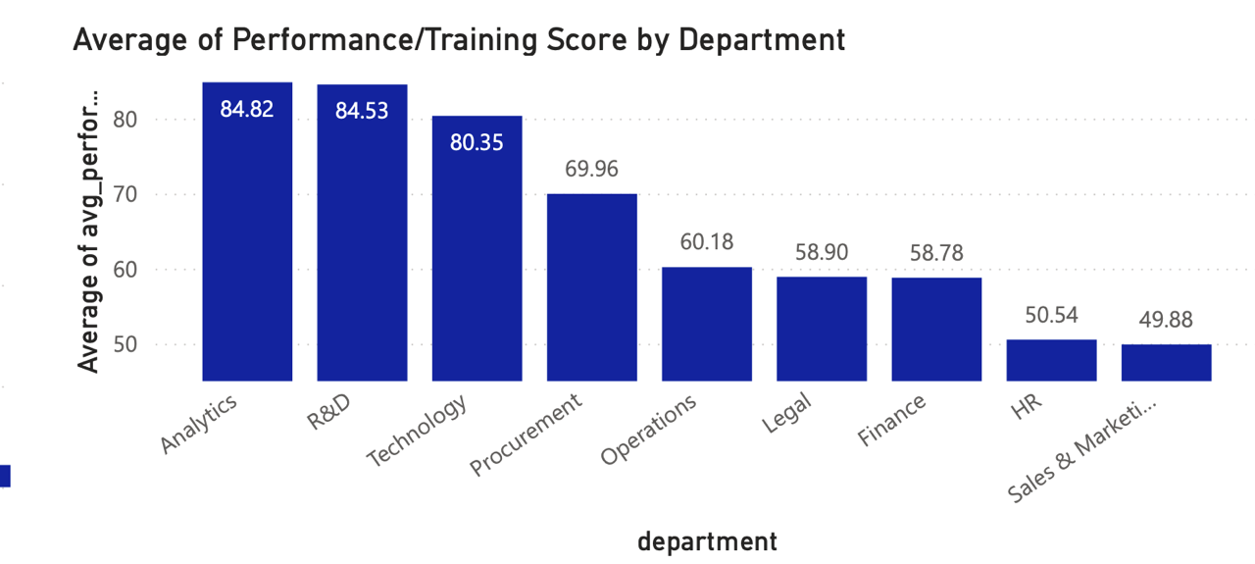

Slide 11
Challenges and Solutions
2. Training and Development Programs
Targeted Learning for Lower-Education Segments
Bachelor’s degree holders (69.4% of the workforce) have the lowest performance (62.89%).
Action:
Implement skill-boosting programs for Bachelor's degree holders, focusing on core competencies relevant to each department.
Provide access to advanced certifications or sponsor Master’s-level learning for high-potential employees.
Sales & Marketing and HR Upskilling
Focus on building specific technical, digital, and customer-facing skills for Sales & Marketing.
For HR, strengthen strategic HR capabilities (e.g., talent analytics, employee relations, change management).

Slide 12
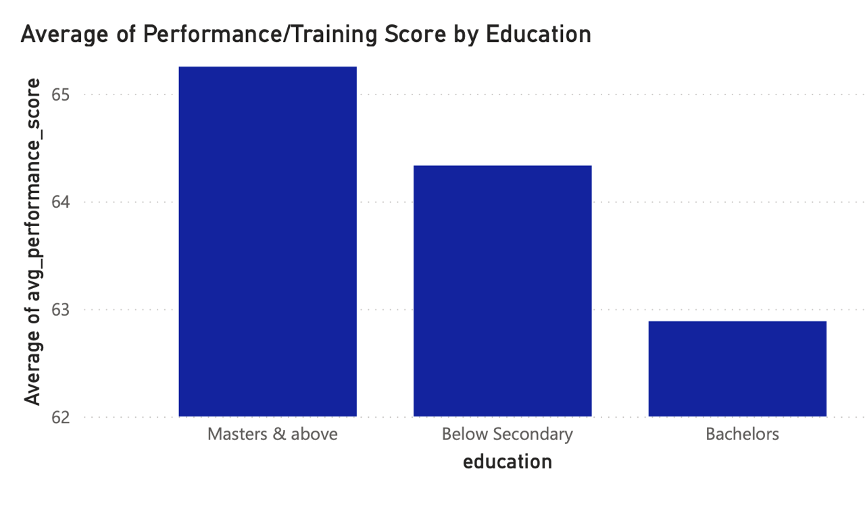

Slide 13
Challenges and Solutions
Leadership Development
Male employees with Master’s & above demonstrate higher tenure—leverage them as mentors.
Develop a leadership pipeline with a focus on high performers from Analytics and Technology.

Slide 14
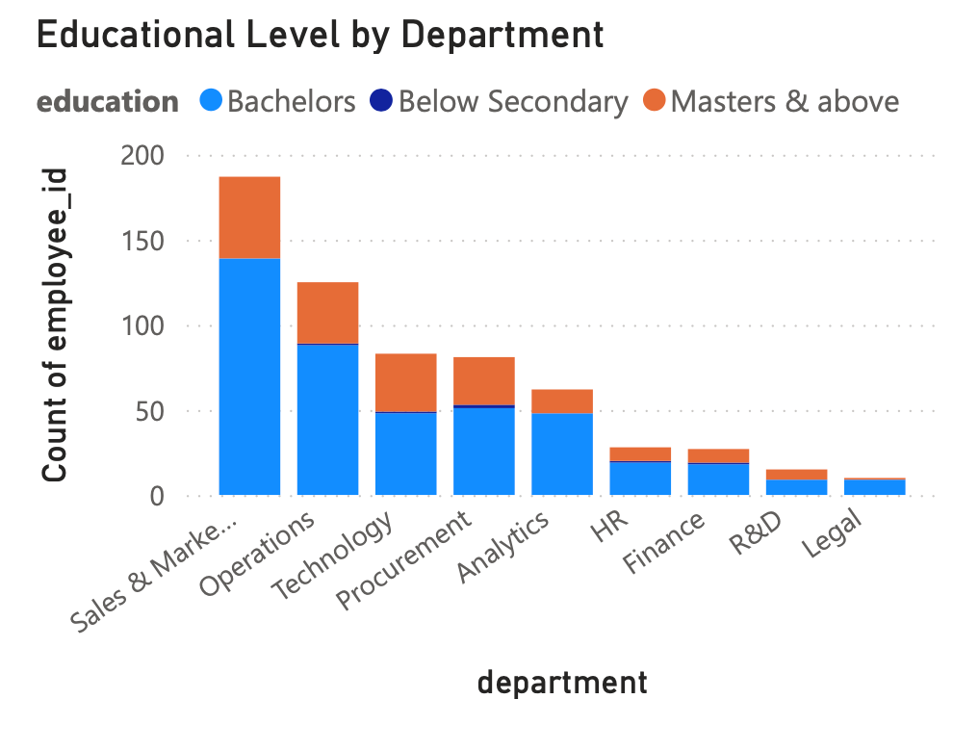

Slide 15
Challenges and Solutions
3. Employee Engagement Initiatives
Engage Sales & Marketing and HR Teams
Launch listening sessions and pulse surveys to identify specific engagement drivers for these teams.
Consider tailored recognition programs and incentives to motivate and retain talent.
Promote Career Growth Pathways
Highlight success stories of long-tenured female employees, particularly in HR and Technology, to inspire and motivate others.
Develop transparent career frameworks showing how employees can grow within the organization.

Slide 16
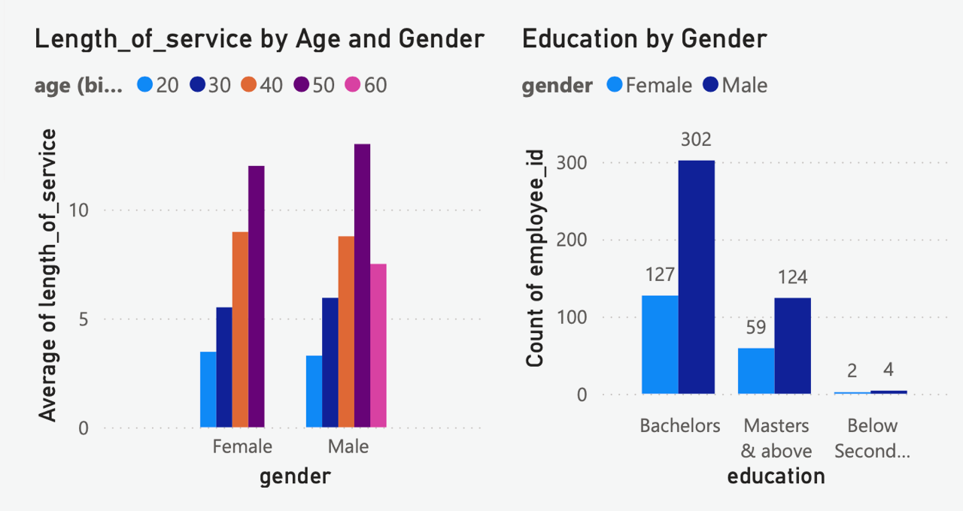

Slide 17
Challenges and Solutions
Enhance Diversity & Inclusion
With a 69.4% Bachelor's degree majority and gender disparities in tenure, ensure equitable access to learning and leadership opportunities across education levels and gender groups.
Well-being Programs for At-Risk Departments
Departments with high support needs (Sales & Marketing, HR) may be facing burnout or morale issues.
Introduce mental health resources, flexible work options, and team-building activities to foster a positive environment.

Slide 18
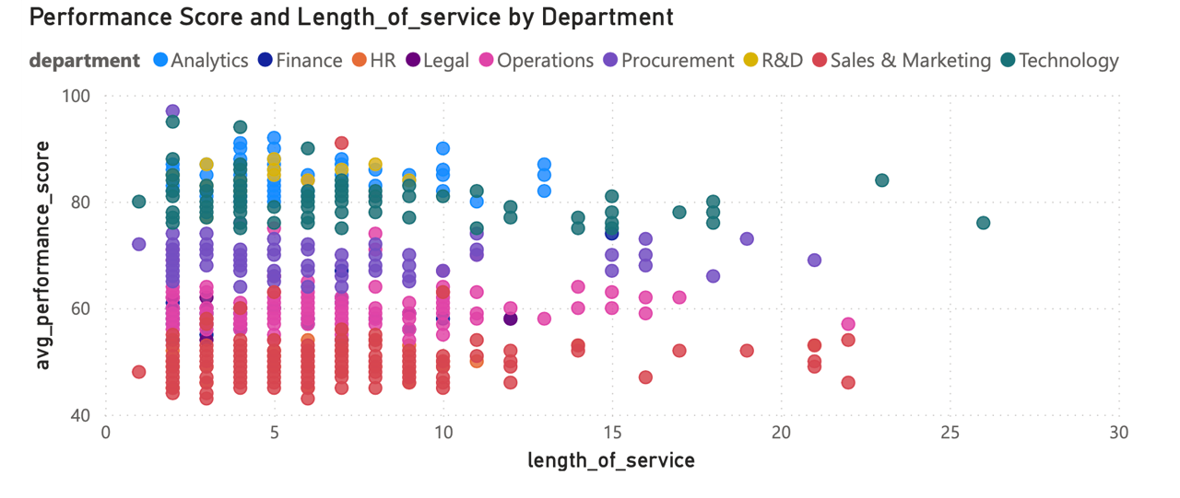

Slide 19


Final Recommendation
For HR & Leadership Teams
Establish a Performance Improvement Task Force to implement these recommendations.
Set quarterly goals for reducing support needs in at-risk departments by 15-20% over the next 6-12 months.
Regularly track and report on:
Performance score trends
Tenure changes
Training impact (pre/post analysis)
Employee satisfaction metrics
Talent Management Decisions
Training and Development Programs
Employee Engagement Initiatives

Slide 20
Pearl Elenwo Inc.
Thank You
Contact Information
Address: 504 Pearl St., Manchester
Phone: +44-7400-780000
Email: hello@rpearlelenwo.com
Website: www.pearlelenwo.com

